Slide 1
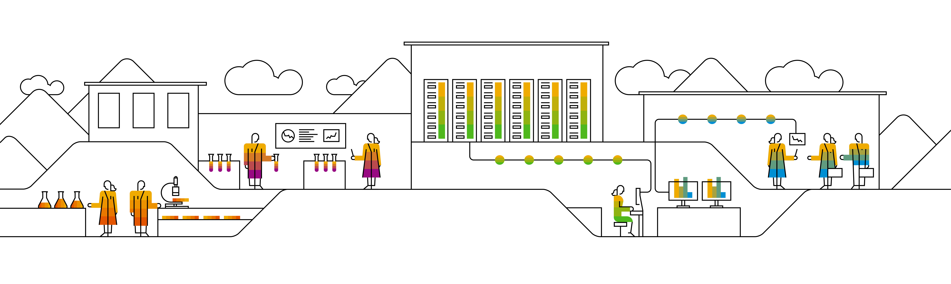
CockroachDB A Geo-distributed SQL Database
Speaker’s Name, SAP
Month 00, 2020
Partner logo

Slide 2
Agenda
Agenda item/divider headline
Details
Agenda item/divider headline
Details
Agenda item/divider headline
Details
Agenda item/divider headline
Details

Slide 3
The Overview of CockroachDB

Slide 4
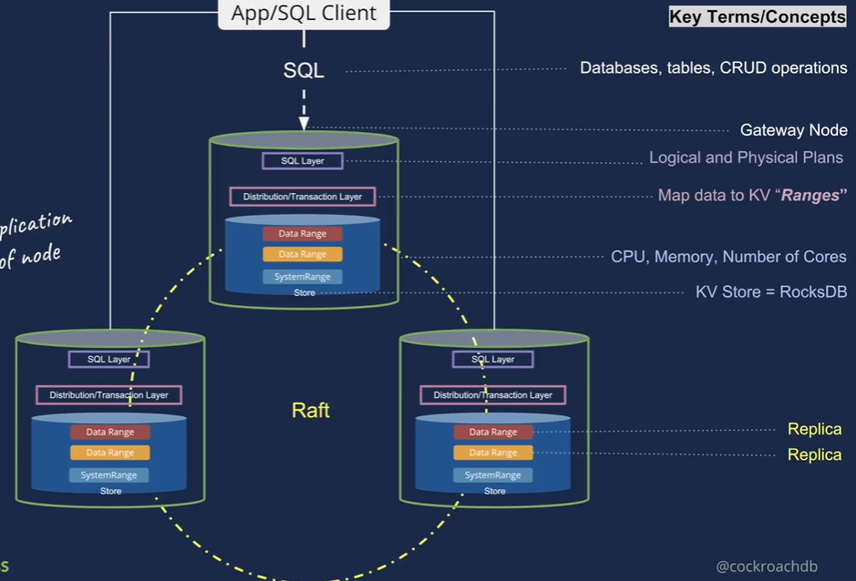
Introduction of CockroachDB
Make Data Easy
Distributed
Horizontally scalable to grow with your application
Geo-distributed
Handle datacenter failures
Place data near usage
Push computation near data
SQL
Lingua-franca for rich data storage
Schemas, indexes, and transactions make app development easier

Slide 5
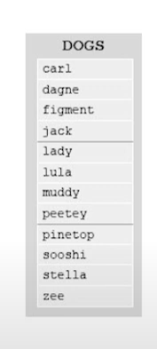
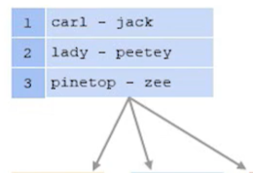
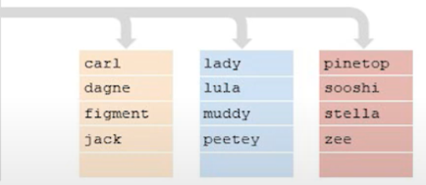
Distributed, Replicated, Transactional KV
Keys and values are strings
Lexicographically ordered by key
Multi-version concurrency control (MVCC)
Values are never updated in place
Tombstones are used to delete values
Provides snapshot to each transaction
Monolithic key-space
Key space divided into contiguous – 64MB
Ranges are small enough to moved/split quickly AND large enough to amortize indexing overhead
Index structure used to locate ranges

Slide 6
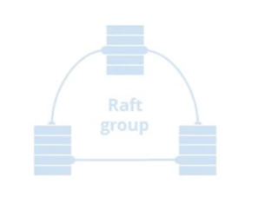
Raft and Replication
Ranges are the unit of replication
Each range is a Raft group
Raft is a distributed consensus protocol
Default to 3 replicas, though this is configurable
Raft provides “Atomic replication” of commands
Each group elects a leader
Commands require majority if replicas to vote

Slide 7
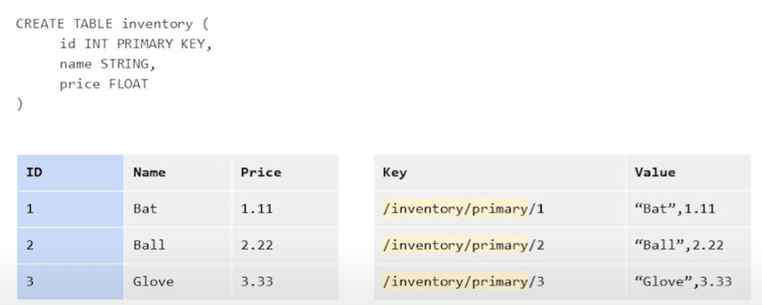
SQL: Tabular Data in a KV World
The SQL data model needs to be mapped to KV data
SQL Data Mapping: Inventory Table

Slide 8
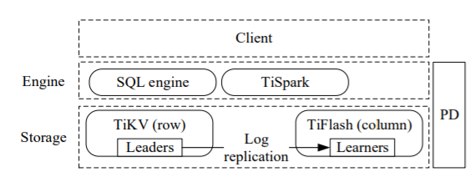

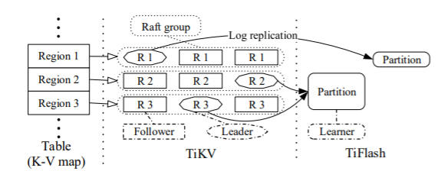
TiDB Architecture
It has three core components:
A distributed storage layer
A row store(TiKV)
A columnar store(TIFlash)
A Placement Driver
Managing regions
Supplying each key’s region and physical location
A computation engine layer

Slide 9
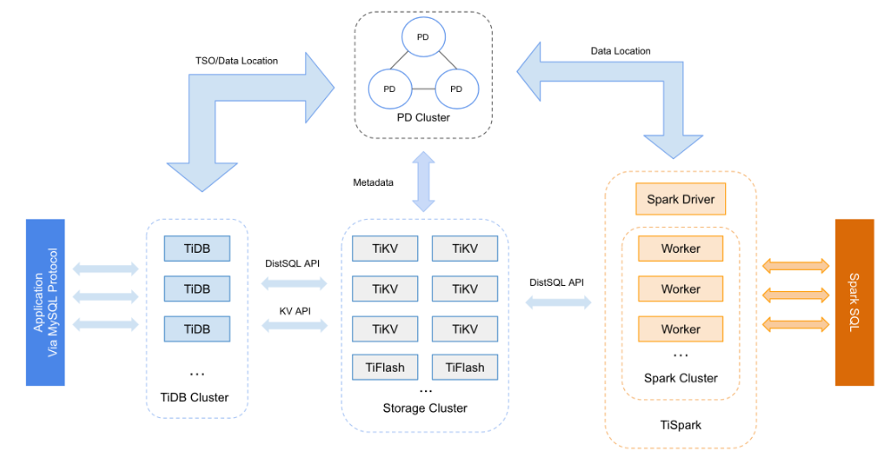
TiDB Architecture

Slide 10
Thank you.
Contact information:
F name L name
Title
Address
Phone number
Partner logo

